Slide 1
Cryptography and Network Security Chapter 9
Fourth Edition
by William Stallings
Lecture slides by Lawrie Brown
Notes:
Lecture slides by Lawrie Brown for “Cryptography and Network Security”, 4/e, by William Stallings, Chapter 9 – “Public Key Cryptography and RSA”.

Slide 2
Chapter 9 – Public Key Cryptography and RSA
Every Egyptian received two names, which were known respectively as the true name and the good name, or the great name and the little name; and while the good or little name was made public, the true or great name appears to have been carefully concealed.
—The Golden Bough, Sir James George Frazer
Notes:
Opening quote.

Slide 3
Drawback of Secret Key Crypt
Key Distribution – Safe and authenticated distribution of keys – very difficult – condition worsens when keys are changed frequently
Key Management: N nodes in a n/w => N-1 keys with each node.
Difficult to provide Digital Signature schemes that provide non-repudiation services.
Solution: Public Key Cryptography (PKC)

Slide 4
Public Key Cryptography
Operations: Addition, Multiplication, and exponentiation
Security is based on complexity of mathematical functions ( intractable problems)
Examples: RSA, Diffie Hellman, Rabin, ElGamal, Elliptic curve cryptography etc.

Slide 5
Public-Key Cryptography (PKC)
public-key/two-key/asymmetric cryptography uses two keys:
public-key, known to everybody, used to encrypt messages, and verify signatures
private-key, known only to the recipient(owner), used to decrypt messages, and sign messages (create signatures)
It is asymmetric because
Same key is not used for encryption and decryption.
Therefore, those who encrypt messages or verify signatures cannot decrypt messages or create signatures
Notes:
Emphasize here the radical difference with Public-Key Cryptography is the use of two related keys but with very different roles and abilities. Anyone knowing the public key can encrypt messages or verify signatures, but cannot decrypt messages or create signatures, all thanks to some clever use of number theory.

Slide 6
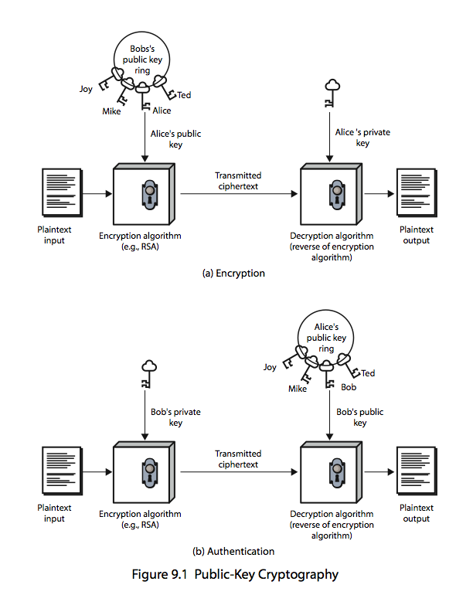
PKC for Confidentiality without authentication

Slide 7
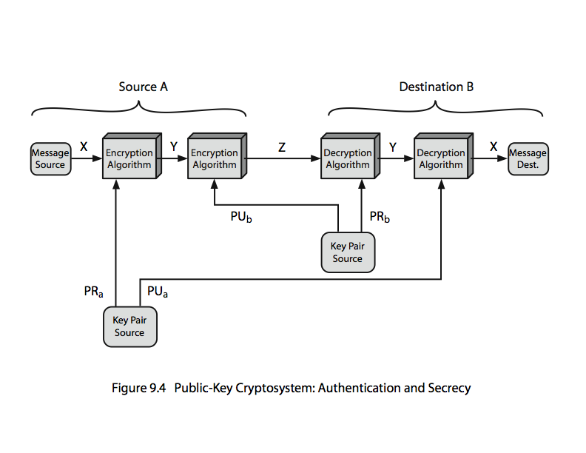
PKC for Confidentiality with Authentication

Slide 8
Applications of PKC
3 categories of applications:
encryption/decryption (provide secrecy)
digital signatures (provide authentication)
key exchange (of session keys)
Notes:
Public-key systems are characterized by the use of a cryptographic type of algorithm with two keys. Depending on the application, the sender uses either the sender’s private key or the receiver’s public key, or both, to perform some type of cryptographic function. In broad terms, we can classify the use of public-key cryptosystems into the three categories:
• Encryption/decryption: The sender encrypts a message with the recipient’s public key.
• Digital signature: The sender “signs”a message with its private key, either to the whole message or to a small block of data that is a function of the message.
• Key exchange: Two sides cooperate to exchange a session key. Several different approaches are possible, involving the private key(s) of one or both parties.
Some algorithms are suitable for all three applications, whereas others can be used only for one or two of these applications.

Slide 9
Security of Public Key Schemes
like private key schemes brute force exhaustive search attack is always theoretically possible
but keys used are too large (>512bits)
security relies on a large enough difference in difficulty between easy (en/decrypt) and hard (cryptanalyse) problems
more generally the hard problem is known, but is made hard enough to be impractical to break
requires the use of very large numbers
hence is slow compared to private key schemes
Notes:
Public key schemes are no more or less secure than private key schemes - in both cases the size of the key determines the security. Note also that you can't compare key sizes - a 64-bit private key scheme has very roughly similar security to a 512-bit RSA - both could be broken given sufficient resources. But with public key schemes at least there is usually a firmer theoretical basis for determining the security since its based on well-known and well studied number theory problems.

Slide 10
Intractable problems and Security of PKC
Integer factorization: n = p * q. Finding primes p and q, given n. Eg: RSA (Soln: NFS with subexponetial running time)
Discrete Logarithmic Problem: x = y^{z} % p. Finding z, given x, y and p. Eg: Diffie Hellman alg, ElGamal Alg, DSA. (Soln:Pollard rho with Fully Exp, NFS with sub exponential time)
ECDLP: P= nQ, where P and Q are points on elliptic curve. Finding n, given P and Q. Eg: ECC (Soln: Pollard rho having Fully exponential time )

Slide 11
PKC Algorithms
RSA Algorithm
Diffie Hellman Algorithm
DSA-Digital Signature Algorithm
Elliptic Curve Cryptography

Slide 12
RSA Algorithm
by Rivest, Shamir & Adleman of MIT in 1977
Key Generation:
Select any two distinct prime numbers p & q.
Compute n=p*q and φ(n) = (p-1)*(q-1)
Select a random number ‘e’ such that 1<e<φ(n) and gcd( e, φ(n) ) =1.
Compute e’s inverse: d=e⁻¹ mod φ(n)
Public Key = (n,e); Private Key = (p,q,d)

Slide 13
RSA…
Encryption: Let x<n be a plain text (number)
y = E_{Pub}(x) = x^{e} mod n
Decryption:
x = D_{pvt}(y) = y^{d} mod n
Note: Message is represented as a seqn of 0’s and 1’s. Find integer (biggest) k such that 2^{k} < n (i.e., k<log₂ n). Then k bits of message (whose integer value is x) is encrypted.
Above encr/decr provides confidentiality. Swap(Pub, Pvt) keys in the above for providing authentication

Slide 14
RSA Example.
Assume the following:
Sender: A Receiver: B
B’s (pub, pvt) key pair generation:
B selects primes p=17, q=11 and computes n=p*q=187 and φ(n) = (p-1)*(q-1)=160
B selects a random no e=7 satisfying the required condition and calculates its inverse d as 23 using extended Euclid’s algorithm.
B’s public Key=(n,e)=(187,7) and private key = (p,q,d) = (17,11, 23). B announces its public key to all

Slide 15
A wants to send encrypted message to B
‘A’ generates a message and say its integer value is x=88 (<n)
‘A’ encrypts the plain text x with B’s public key as: y=88⁷ mod 187 = 11 and transmits it to B
‘B’ decrypts the cipher text 11 as x=11²³ mod 187 = 88.

Slide 16
RSA Security
possible approaches to attacking RSA are:
brute force key search (infeasible given size of numbers)
mathematical attacks (based on difficulty of computing ø(n), by factoring modulus n)
timing attacks (on running time of decryption)
chosen ciphertext attacks (given properties of RSA)
Notes:
Note some possible possible approaches to attacking the RSA algorithm, as shown.
The defense against the brute-force approach is the same for RSA as for other cryptosystems, namely, use a large key space. Thus the larger the number of bits in d, the better. However because the calculations involved both in key generation and in encryption/decryption are complex, the larger the size of the key, the slower the system will run.
Will now review the other possible types of attacks.

Slide 17
Computing power needed to compute integer factorization using NFS method.
Key size MIPS – years
512 3 X 10⁴
768 2 X 10⁸ 1024 3 X 10¹¹ 1280 1 X 10¹⁴ 1536 3 X 10¹⁶
2048 3 X 10²⁰

Slide 18
Key sizes for equivalent security levels
Symmetric ECC DH/DSA/RSA
80 160 1024
128 256 3072
192 384 7680
256 512 15360

Slide 19
Computing power needed to compute ECDLP using Pollard rho method.
Key size MIPS – years
160 8.5 X 10¹¹
186 7.0 X 10¹⁵ 234 1.2 X 10²³ 354 1.4 X 10¹¹ 426 9.2 X 10⁵¹

